Slide 1
Leveraging ml for movie review sentimental analysis
PALLA LAKSHMI NARASIMHA - 521208
RAMAVATH SIDDHARTHA - 521223
RAPOLU SAI SANDEEP REDDY - 521224
SANGANI ABHINAV KARTHIKEYA - 521231
MINI PROJECT
ADVISOR : DR. SRI PHANI KRISHNA

Slide 2
Introduction
In today's digital age, where opinions are shared at an unprecedented pace, understanding customer sentiment is paramount for businesses. Movie review sentiment analysis serves as a crucial tool in deciphering audience reactions and preferences. Leveraging machine learning techniques, we have developed a robust system capable of analyzing movie reviews and determining whether the sentiment expressed is positive or negative.
IMPORTANCE OF SENTIMENTAL ANALYSIS
Informs decision-making processes for movie producers, marketers, and distributors.
Provides insights into audience preferences and trends.
Helps in improving product quality and customer satisfaction.

Slide 3
objective statement
The primary objective of our project is to create a user-friendly and efficient platform for movie review sentiment analysis using machine learning techniques, with a specific focus on developing a Flask-based website.

Slide 4
Key Points
1. Enhancing User Experience: The project aims to enhance the user experience by providing a seamless and intuitive interface for analyzing movie reviews. Through the website, users can easily input movie reviews and obtain sentiment analysis results in real-time.
2. Utilizing Machine Learning: Leveraging the power of machine learning, our objective is to develop a robust sentiment analysis model capable of accurately classifying movie reviews as either positive or negative. The model's training process involves learning from labeled movie review data to achieve high accuracy in sentiment prediction.
3. Integration with Flask: A key goal of the project is to integrate the trained machine learning model with the Flask web framework. Flask provides the necessary infrastructure for handling web requests and seamlessly incorporating the sentiment analysis functionality into the website.

Slide 5
Block diagram/flow chart
Data collection and preprocessing
Training the model
Evaluate the model and tune the model
Deploy the trained model
Prediction Using the model

Slide 6
System Architecture : Integrating Flask, Machine Learning, and Preprocessing
Overview:
Our system architecture seamlessly combines the Flask web framework with a machine learning model for movie review sentiment analysis. Additionally, preprocessing techniques such as tokenization and padding are employed to ensure optimal input data for the model.
Components:
Flask Framework:
Central component responsible for handling HTTP requests and responses. Provides routing mechanisms to direct incoming requests to appropriate views. Offers a flexible environment for integrating machine learning models with web interfaces.

Slide 7
2.Machine Learning Model:
Core component for sentiment analysis. Utilizes a Sequential model architecture implemented in TensorFlow/Keras.Comprised of layers including Embedding, Flatten, and Dense layers, trained on labeled movie review data.
3.Tokenization and Padding:
Preprocessing steps applied to input text data before feeding it into the model.
Tokenization: Converts text data into sequences of numerical tokens representing individual words.
Padding: Ensures uniform input size by adding zeros to sequences shorter than a specified length and truncating longer sequences.

Slide 8
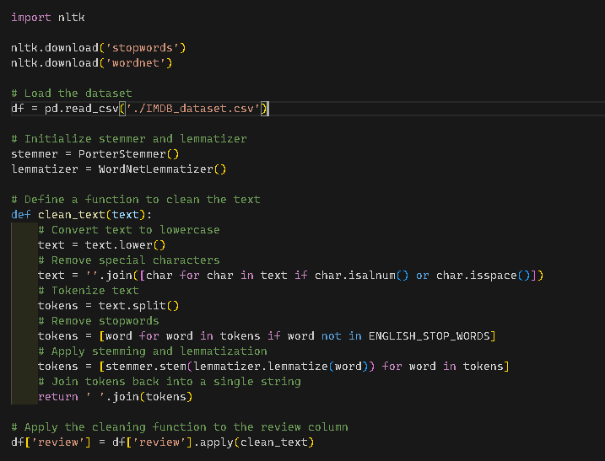
PREPOCESSING
Tokenization: Process of convert text sequences to words or tokens.
Stemming: Process of reducing works to base form.
Lemmatization : Advanced Verion of Stemming with more effcient

Slide 9
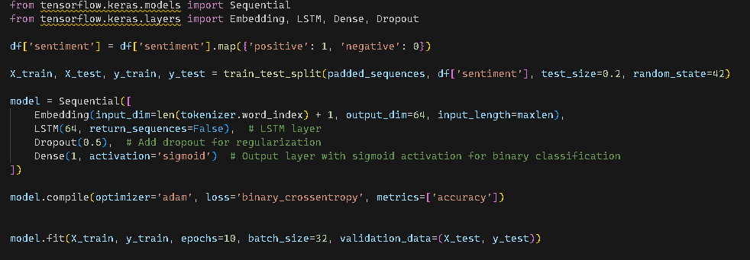
BUILD THE MODEL
LSTM:
Long Short-Term Memory (LSTM) is a type of recurrent neural network (RNN) architecture used in deep learning for tasks that involve sequence data.
LSTMs are designed to address the vanishing gradient problem that often affects traditional RNNs, enabling them to learn long-range dependencies in data more effectively.

Slide 10
Website functionality
Website Input Interface:
Users are greeted with a user-friendly interface upon visiting the website.
The input interface provides a text box or a form where users can enter their movie reviews.
It is designed to be intuitive and easy to use, allowing users to input their reviews effortlessly.
Output Display for Sentiment Analysis Results:
After users submit their movie reviews, the system performs sentiment analysis in real-time.
The sentiment analysis results, indicating whether the review is positive or negative, are displayed to the users.

Slide 11





Software
Tensorflow
Python 3.7
Keras
Flask
HTML
Tailwind
Dataset : IMDB Dataset

Slide 12
Model Training :
1. Data Preparation:
Before training the model, the dataset is prepared by preprocessing the movie review data.
Preprocessing steps may include tokenization, padding, and converting sentiment labels to numerical values.
2. Sequential Model Architecture:
Our sentiment analysis model follows a Sequential architecture using TensorFlow/Keras.
It consists of an Embedding layer, Flatten layer, and Dense layers.
The Embedding layer learns to map words to dense vectors, while Dense layers perform classification based on learned features.

Slide 13
3. Training Data Split:
The dataset is split into training and testing sets to evaluate the model's performance.
Typically, a portion of the dataset (e.g., 80%) is used for training, while the remaining portion is reserved for testing.

Slide 14
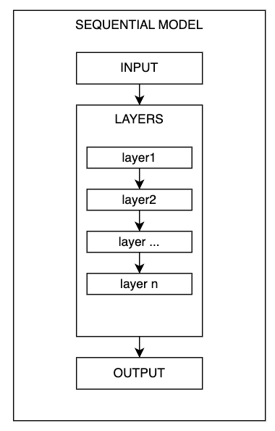
Sequential model
In Keras, a Sequential model is a linear stack of layers. You can create a Sequential model and add layers to it one by one. This approach is suitable for most deep learning tasks where the data flows sequentially through each layer of the network.

Slide 15
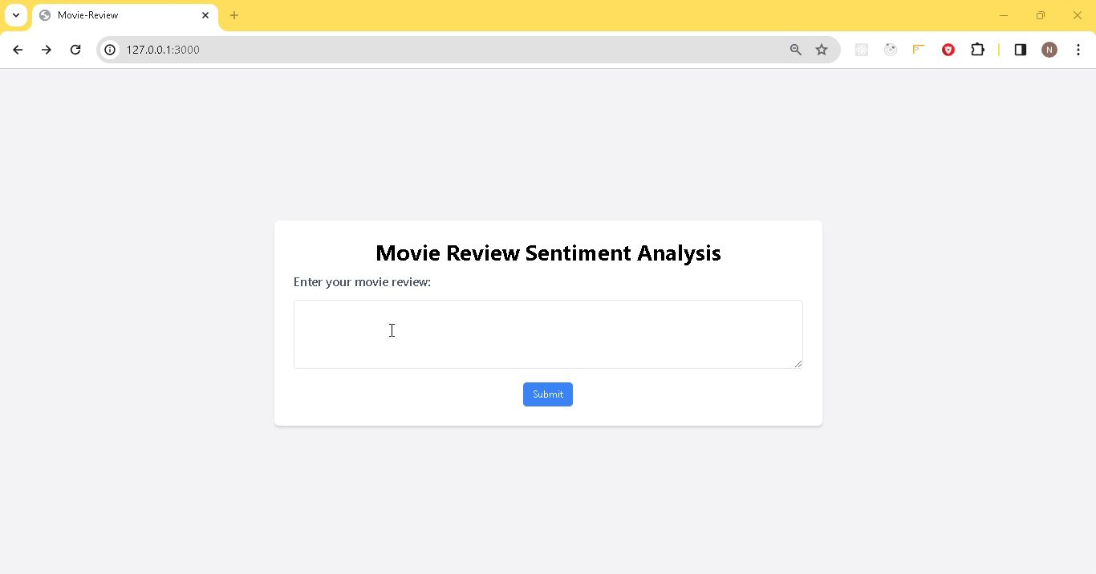
Website demonstration

Slide 16
conclusion
Project Objectives:
We set out to develop a Flask-based website for movie review sentiment analysis, leveraging machine learning techniques. Our goal was to create a user-friendly platform that provides real-time sentiment analysis results to users.
2. System Architecture:
We discussed the architecture of our system, which seamlessly integrates the Flask framework with a machine learning model. Components such as routing, views, and preprocessing techniques like tokenization and padding were used.
3. Website Functionality:
The website offers a user-friendly input interface for submitting movie reviews and displays sentiment analysis results promptly.
4. Model Training and Evaluation:
The model training process involves preparing the dataset, defining the Sequential model architecture, and splitting the data for training and testing. Model evaluation measures performance using metrics like loss and accuracy, providing insights into its effectiveness.

Slide 17
referEnces
YOUTUBE VIDEO LINK: ml_project-Video_link
Abadi, Martín, etjal. "TensorFlow: Large-scale machine learning on heterogeneous systems." arXiv preprint arXiv:1603.04467 (2016).
Flask Documentation
https://keras.io/
StackOverFlow
kaggle

